Slide 1



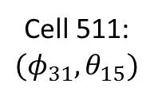





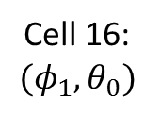



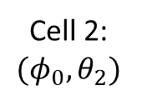


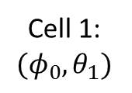




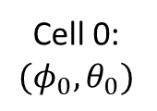
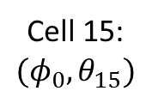


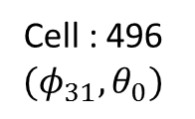
Cell 0:
$$(φ_{0},θ_{0})$$
Cell 1:
$$(φ_{0},θ_{1})$$
Cell 2:
$$(φ_{0},θ_{2})$$
Cell 15:
$$(φ_{0},θ_{15})$$
$$…$$
$$…$$
Azimuthal Angle $φ$
Cell 16:
$$(φ_{1},θ_{0})$$
$$…$$
$$…$$
$$…$$
$$…$$
$$…$$
$$…$$
$$…$$
$$…$$
$$…$$
$$…$$
$$…$$
Cell : 496
$$(φ_{31},θ_{0})$$
$$…$$
$$…$$
$$…$$
$$…$$
Cell 511:
$$(φ_{31},θ_{15})$$
Polar Angle $θ$

Slide 2
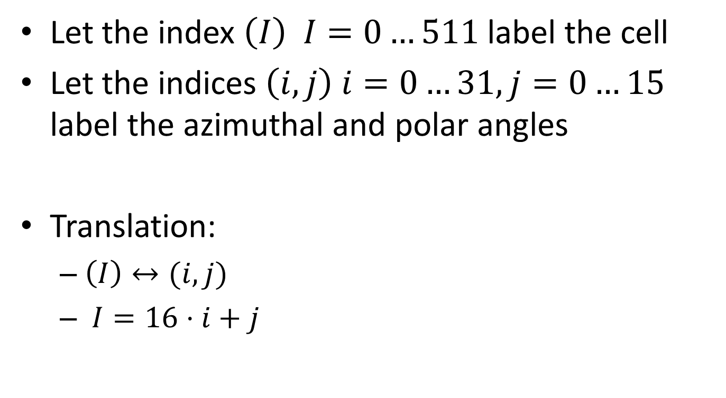
Combined Spectrometer Fields-of-View
Let the index $\left(I\right) I=0…511$ label the cell
Let the indices $\left(i,j\right) i=0…31, j=0…15$ label the azimuthal and polar angles
Translation:
$\left(I\right)↔(i,j)$
$I=16⋅i+j$

Slide 3
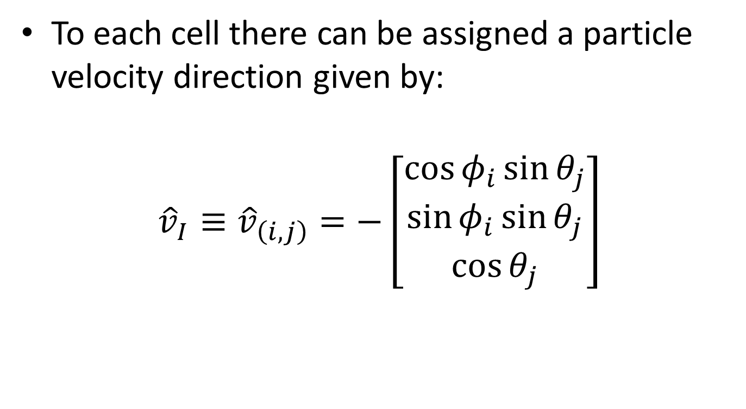
Velocity Directions
To each cell there can be assigned a particle velocity direction given by:
$${\hat{v}}_{I}≡{\hat{v}}_{\left(i,j\right)}=−\left[\begin{aligned}\cos{φ_{i}}\sin{θ_{j}} \\ \sin{φ_{i}}\sin{θ_{j}} \\ \cos{θ_{j}}\end{aligned}\right]$$

Slide 4
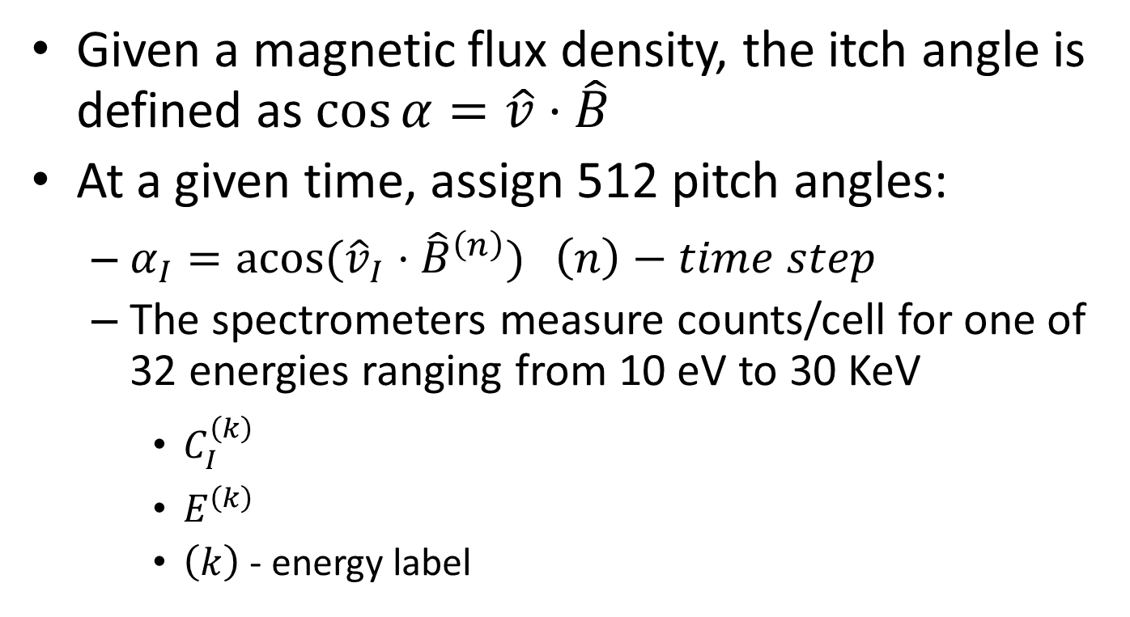
Pitch Angles
Given a magnetic flux density, the itch angle is defined as $\cos{α}=\hat{v}⋅\hat{B}$
At a given time, assign 512 pitch angles:
$α_{I}=\operatorname{acos}{({\hat{v}}_{I}⋅{\hat{B}}^{\left(n\right)})} \left(n\right)−time step$
The spectrometers measure counts/cell for one of 32 energies ranging from 10 eV to 30 KeV
$C_{I}^{\left(k\right)}$
$E^{\left(k\right)}$
$\left(k\right)$ - energy label

Slide 5


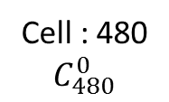






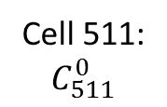



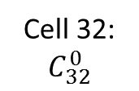
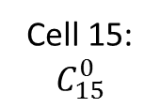





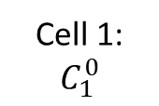

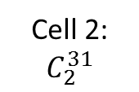





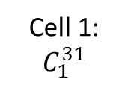


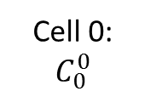

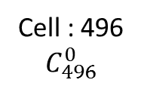




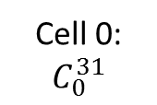
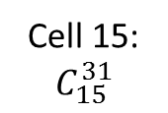


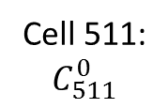
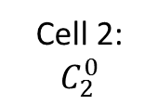

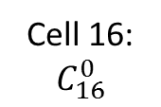

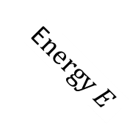
Cell 0:
$$C_{0}^{31}$$
Cell 1:
$$C_{1}^{31}$$
Cell 2:
$$C_{2}^{31}$$
Cell 15:
$$C_{15}^{31}$$
$$…$$
$$…$$
E$nergy E$
Cell 0:
$$C_{0}^{0}$$
Cell 1:
$$C_{1}^{0}$$
Cell 2:
$$C_{2}^{0}$$
Cell 15:
$$C_{15}^{0}$$
Cell 32:
$$C_{32}^{0}$$
$$…$$
$$…$$
$$…$$
$$…$$
$$…$$
$$…$$
$$…$$
Azimuthal Angle $φ$
Cell 16:
$$C_{16}^{0}$$
$$…$$
$$…$$
$$…$$
$$…$$
$$…$$
$$…$$
$$…$$
$$…$$
$$…$$
$$…$$
$$…$$
$$…$$
$$…$$
$$…$$
$$…$$
$$…$$
$$…$$
Cell : 480
$$C_{480}^{0}$$
$$…$$
$$…$$
$$…$$
$$…$$
Cell 511:
$$C_{511}^{0}$$
Cell : 496
$$C_{496}^{0}$$
$$…$$
$$…$$
$$…$$
$$…$$
Cell 511:
$$C_{511}^{0}$$
Polar Angle $θ$

Slide 6
Function Summary (1/n)
unpack_FS_dist_CDF(cdf_fh,MMS,species): put contents of distribution CDF file into two python dictionaries:
FS_dist
‘Dist’ – counts/skymap (4D: time, phi, theta, energy)
‘Err’ – counts/skymap error (4D: time, phi, theta, energy)
‘Epoch’ – calendar epoch
‘Flag’ – data quality flag at the given time
FS_params
‘Erg’ – energy values (1D: 32 long)
‘Phi’ – azimuthal angle (1D: 32 long)
‘Theta’ – polar angle (1D: 16 long)
unpack_FS_moms_CDF(cdf_fh,MMS,species): put contents of moments CDF file into one python dictionary:
FS_moms
‘Vx’ – x-component of the bulk velocity
‘Vy’ – y-component of the bulk velocity
‘Vz’ – z-component of the bulk velocity
‘V’ – the bulk speed

Slide 7
Function Summary (2/n)
fetch_magnetic_field(cdf_fh,MMS,species): put contents of l2pre CDF file into one python dictionary:
B_field
‘Bx’ – x-component of the magnetic flux density
‘By’ – y-component of the magnetic flux density
‘Bz’ – z-component of the magnetic flux density
‘B’ – magnitude of magnetic flux density vector
calculate_incoming_particle_directions(parms): returns the particle velocity directions in a 2D matrix
calculate_pitch_angles(v,bfield,time_label): returns the pitch angles in a 2D matrix

Slide 8
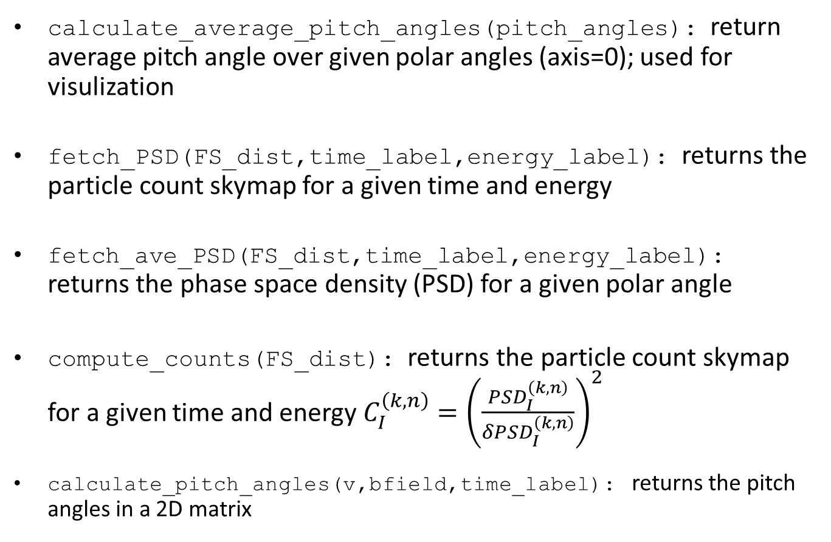
Function Summary (3/n)
calculate_average_pitch_angles(pitch_angles): return average pitch angle over given polar angles (axis=0); used for visulization
fetch_PSD(FS_dist,time_label,energy_label): returns the particle count skymap for a given time and energy
fetch_ave_PSD(FS_dist,time_label,energy_label): returns the phase space density (PSD) for a given polar angle
compute_counts(FS_dist): returns the particle count skymap for a given time and energy $C_{I}^{\left(k,n\right)}={\left(\frac{PSD_{I}^{\left(k,n\right)}}{δPSD_{I}^{\left(k,n\right)}}\right)}^{2}$
calculate_pitch_angles(v,bfield,time_label): returns the pitch angles in a 2D matrix

Slide 9

Function Summary (4/n)
compute_number_flux(FS_dist,FS_params): returns the differential particle flux skymap in a 2D matrix using $jN_{I}^{\left(k,n\right)}=PSD_{I}^{\left(k,n\right)}2{\left(\frac{E}{m_{e}}\right)}^{2}$

